Slide 1


Airbnb Database
Team 9: Sylvie Zhou, Jason Hamilton,
Mild Trakarnsakdikul, Faarid Sanaan

Slide 2




Team 9 Introduction
Mild Trakarnsakdikul
Jason Hamilton
Sylvie Zhou
Faarid Sanaan

Slide 3
Business Understanding
Airbnb is a community-based, two-sided online marketplace that facilitates and connects people who want to rent out their home with people who are looking for lodging in a specific location around the world.
Their revenue is from:
Commission host
Everytime guest makes payment, Airbnb takes 10% of the payment amount as commission.
Guest Transaction fee
When travelers make payments for stays, they are charged a 3% fee for the transaction.

Slide 4
Stakeholders
Bed & Breakfast
Prioritize their revenue stream by focusing on:
Listing Hosts
Staying Guests

Slide 5
Business Question
Their biggest assets are the individuals who book through Airbnb and the hosts that post the stay listings.
A beneficial investigation should focus on queries relating to the listing, host and guest information:
What are the popular listings type in different location/region?
What are the trends and seasonality of the listing in each region?
How does pricing differ by region?
What is the availability by region?
How do prices vary over time by region?
How does the number of listings vary for each region?
How long is the booking time by region?

Slide 6
Data Understanding
We are exploring Airbnb’s United States data that is posted through Kaggle. The dataset is separated by the state and city the listing is located in.
For feasibility we decided to focus on the West Coast data:
2.47 GB of Data
6 States
California, Colorado, Hawaii, Nevada, Oregon, Washington
14 Cities
4 tables in each city in the state
listing, calendar, reviews and neighborhoods
Source: http://insideairbnb.com/get-the-data/

Slide 7
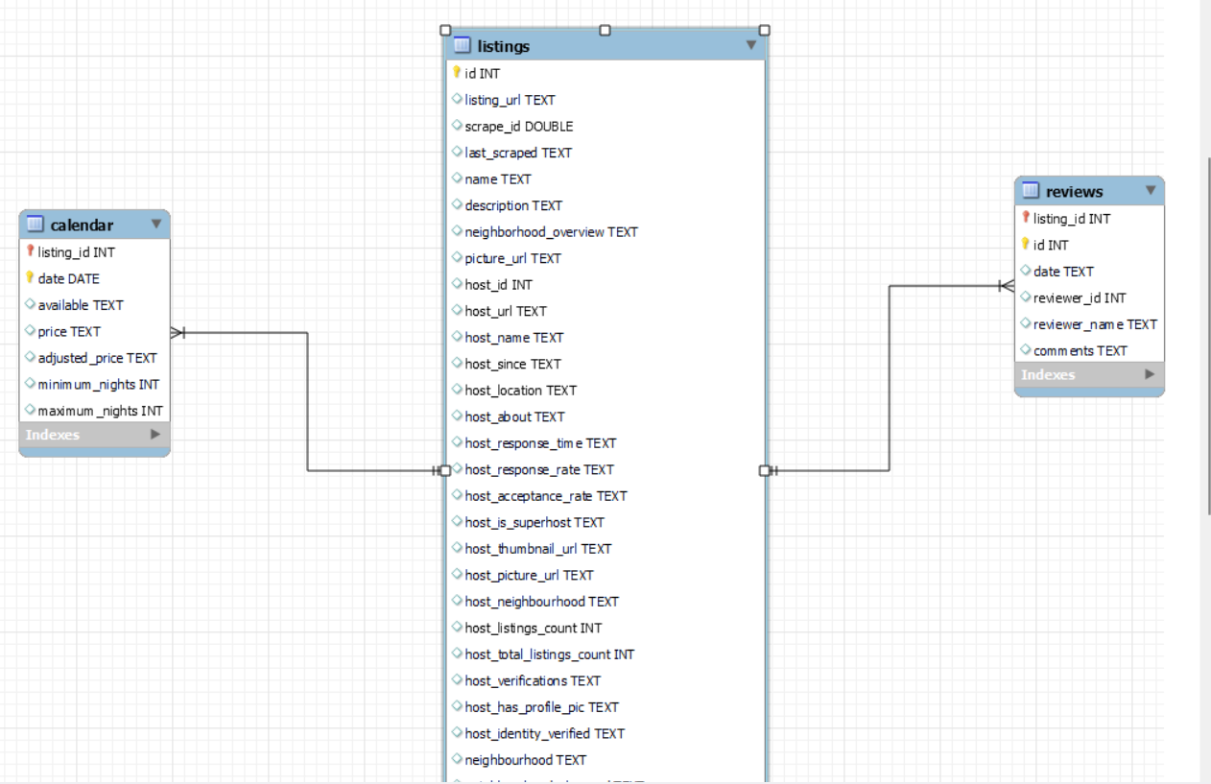
Forming a Database
By using the STAR method we create an ER diagram to show how each data table would be connected:

Slide 8
Exploratory Data Analysis
Due to the size of the data we uploaded the data into S3 and process the data through Hue using pySpark.
We are using two tables: listing and calendar
After unioning all tables, listing_union:
118,107 observations
Average yearly availability: 175 days/year
Average monthly availability: 8.7 days/month
Calendars_union:
43,100,840 observations
Average price: $230.52/night

Slide 9
Cleaning Data
We cleaned the data using pySpark by:
Removing ‘$’ in price and adjusted price column
calendars_union = calendars_union.withColumn('price',expr("replace(price, '$', '')"))
listings_union = listings_union.withColumn('price',expr("replace(price, '$', '')"))
Removing extra space from state name
listings_union3.withColumn("state", trim(listings_union3.state))
Normalized state name with the same spelling of two capitalized letters
listings_union3.withColumn('state_clean',expr("replace(state_clean, 'Ca ', 'California')"))
listings_union3.withColumn('state_clean',expr("replace(state_clean, 'CA ', 'California')"))

Slide 10
Data Querying
After cleaning the data, we focused on answering the business questions to provide insights to Airbnb and its stakeholder.
Multiple challenges faced:
Issues reading in data due to delimiter
Ex. “Amenities” column separated at incorrect times
Solved with spark.read.option("escape", "\"").option("multiline", True)
Tables may have differing numbers of columns
Solved with .unionByName(, allowMissingColumns=True)
Inconsistent state names, as described during data cleaning

Slide 11
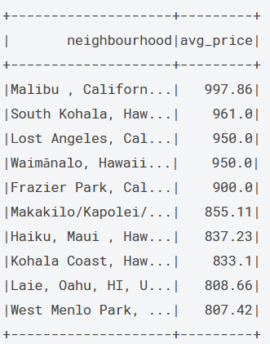
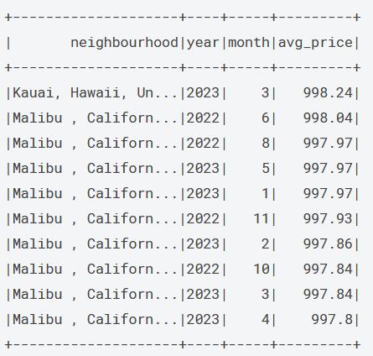
Data Querying - Pricing
Avg Price by Neighbourhood
Avg Price by Date

Slide 12
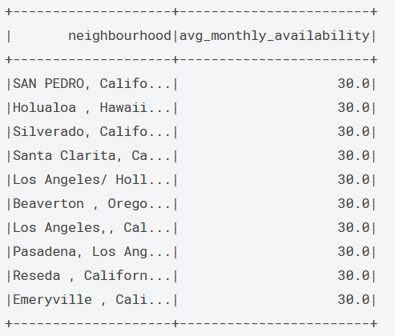
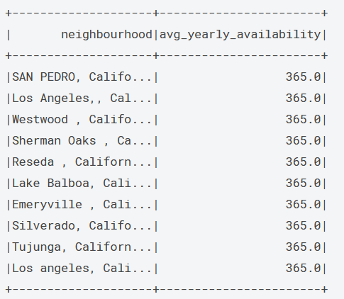
Data Querying - Availability
Monthly
Annually

Slide 13
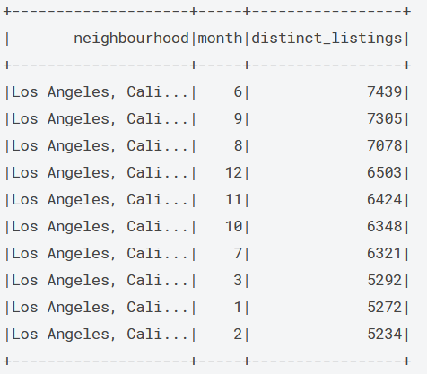
Data Querying - Listing

Slide 14
Data Visualization
After querying the data we wanted to visualized our finding for ease of interpretation and data understanding.
Tableau:
Used Tableau for a state level analysis based on parameters like pricing, availability and popularity.
Plotted bar graphs, treemaps and map to check various variable distributions.
Built line charts to do a time series analysis for availability and pricing across states.
Challenges:
Huge data size resulted in hurdles while loading and joining the two tables.
Performing queries involving disaggregated measures was a limitation because of the size of the dataset.

Slide 15
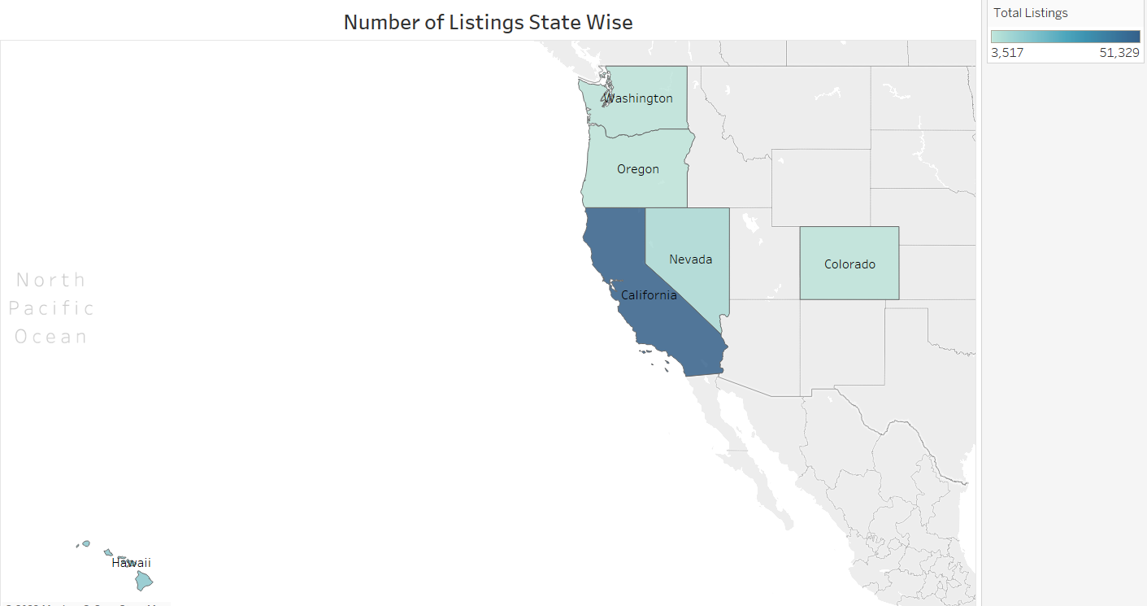
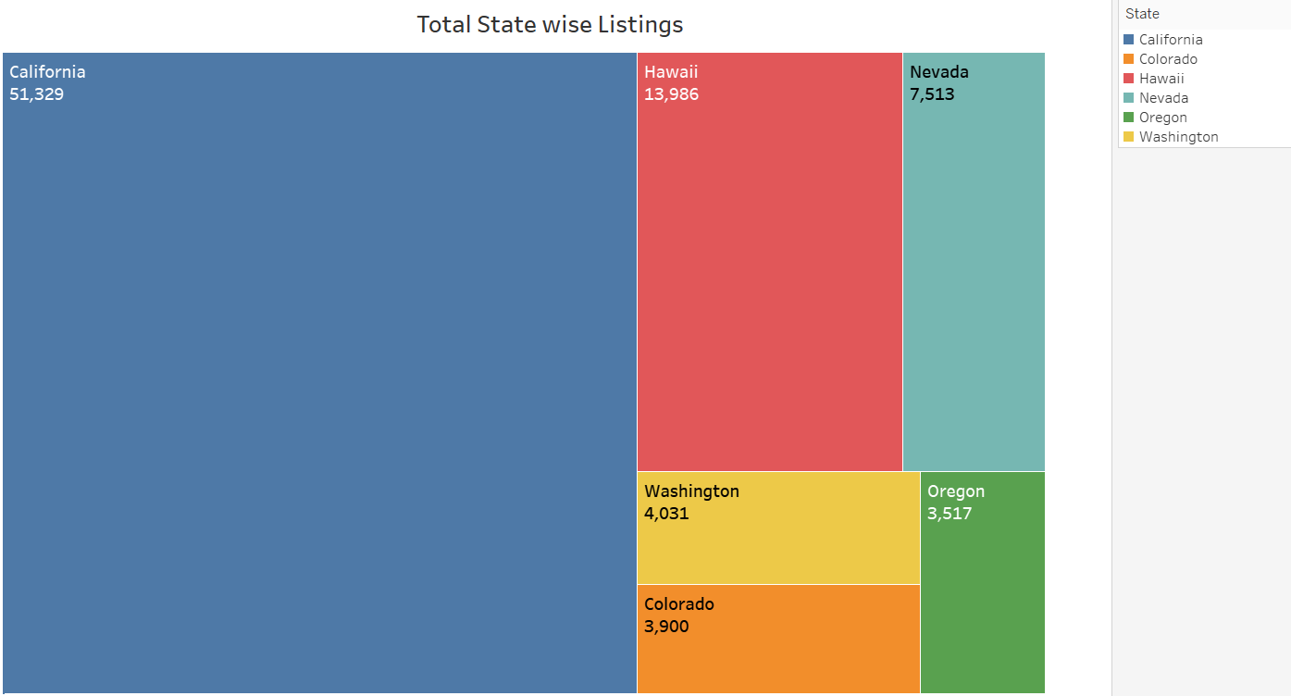
Data Visualization - Listing
How does the number of listings vary across each state?
California have the most listing state wise at 51,929 listings
Oregon have the least listing state wise at 3,517 listings

Slide 16
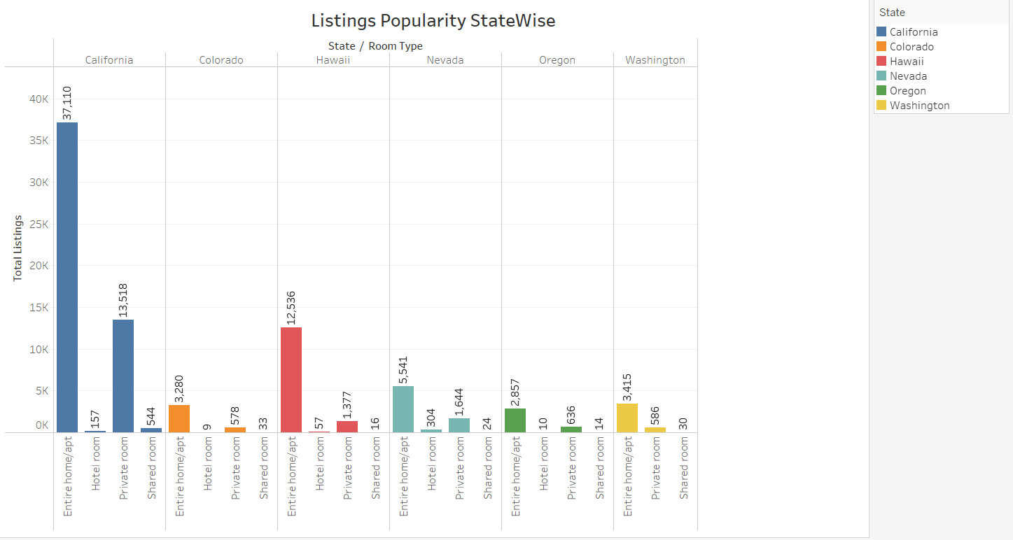
Data Visualization - Popularity
What are the popular type of listings in different states?
In every state entire home and apartment are the most popular
Hotel room and shared rooms are the least popular across all states
Private room were the second popular across all states

Slide 17
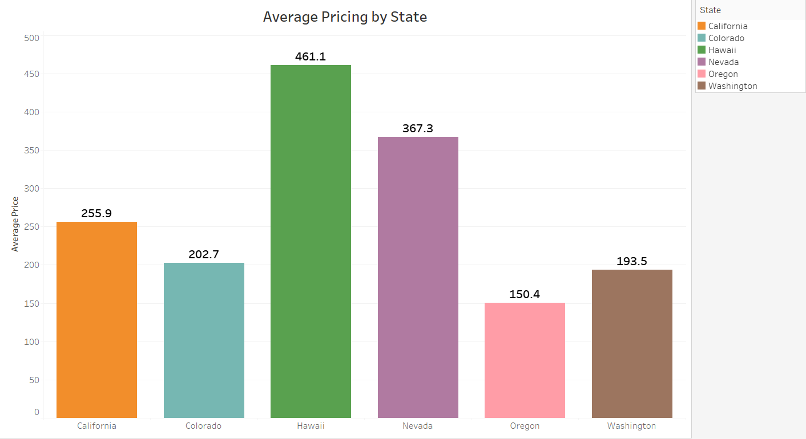
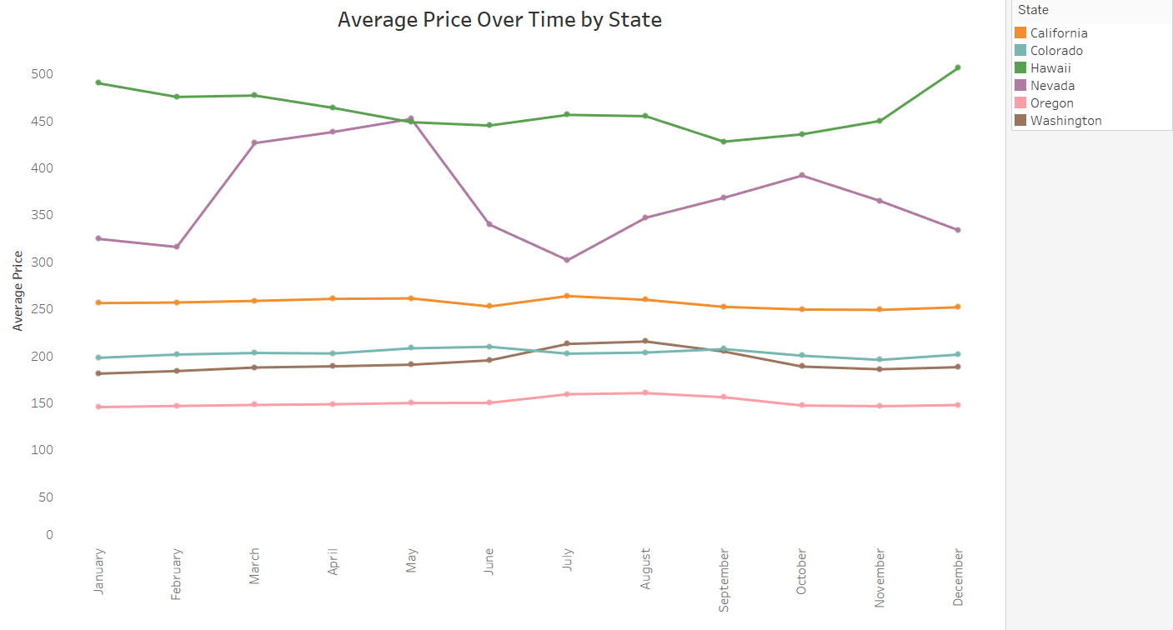
Data Visualization - Pricing
What is the average pricing in each state and over time?

Slide 18
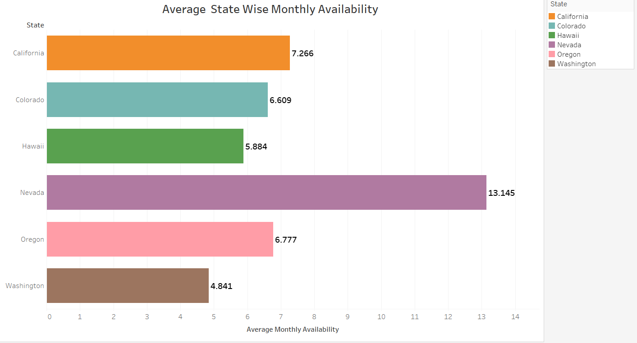
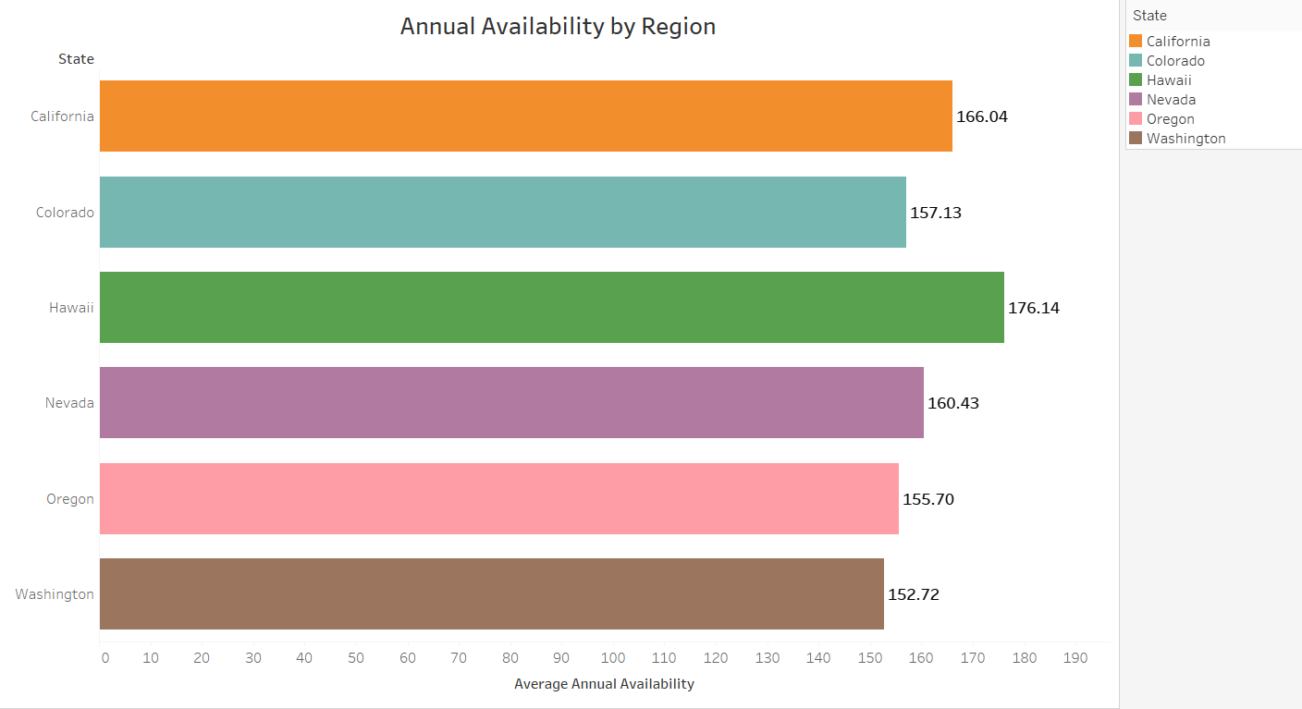
Data Visualization - Availability
What is the monthly and annual availability by each state?

Slide 19
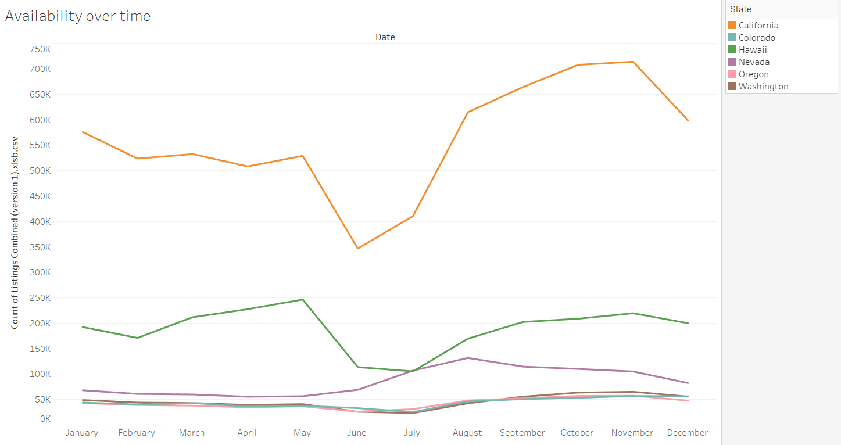
Data Visualization - Seasonality
How does availability differ over time in different states?
The graph was able to show seasonality, we see spike in November and May and a decrease in December
A general increase after June across the states
Beginning of the year seems to be stable

Slide 20
Business Application
Through querying and data visualizations will be able to help Airbnb determine how to generate more revenue.
This can be achieved through:
Targeted advertising popular listings
Targeting guests in different cities and states
The queries provide insights into
Pricing
Listing popularity
Availability
Location-specific details
Airbnb can leverage the information and business strategies to maximize their business reach.

Slide 21
Future Database Improvement
Utilized other region and states data
Include east coast data for comparison
Explore other region trends
Analyze sentiment in airbnb reviews.
Combine with rating to evaluate popularity
Able help hosts to improve their service
Build clustering or multi-class classification model
Recognize the characteristics of successful host/listing.

Slide 22
THANK YOU!

Slide 23
Appendix
Data Querying

Slide 24
Data Querying
How does pricing differ in different cities and states?
The Query:
spark.sql("SELECT l.neighbourhood, ROUND(AVG(c.price), 2) avg_price FROM listings l LEFT JOIN calendar c on l.id = c.listing_id GROUP BY l.neighbourhood ORDER BY avg_price DESC")

Slide 25
Data Querying
How does pricing differ annually and monthly in different cities and states?
The Query:
spark.sql("SELECT neighbourhood, year(to_date(c.date)) year, month(to_date(c.date)) month, ROUND(Avg(c.price), 2) avg_price FROM listings l LEFT JOIN calendar c on l.id = c.listing_id WHERE neighbourhood IS NOT NULL GROUP BY l.neighbourhood, year, month ORDER BY avg_price DESC")

Slide 26
Data Querying
What is the annual availability by each cities and states?
The Query:
spark.sql("SELECT l.neighbourhood, ROUND(AVG(l.availability_365), 0) avg_yearly_availability FROM listings l LEFT JOIN calendar c on l.id = c.listing_id GROUP BY l.neighbourhood ORDER BY avg_yearly_availability DESC")

Slide 27
Data Querying
What is the monthly availability by each cities and states?
The Query:
spark.sql("SELECT l.neighbourhood, ROUND(AVG(availability_30), 0) avg_monthly_availability FROM listings l LEFT JOIN calendar c on l.id = c.listing_id GROUP BY l.neighbourhood ORDER BY avg_monthly_availability DESC")

Slide 28
Data Querying
How does the number of listings vary in different cities and state over time?
The Query:
spark.sql("SELECT l.neighbourhood, month(to_date(c.date)) month, count(DISTINCT(c.listing_id)) distinct_listings FROM listings l LEFT JOIN calendar c ON l.id = c.listing_id WHERE instr(c.available, 't') >=1 AND neighbourhood IS NOT NULL GROUP BY l.neighbourhood, month ORDER BY distinct_listings DESC")

Slide 29
Appendix
2. Data Visualizations

Slide 30
Data Visualization
How does pricing differ in different states?
Hawaii have the highest average price of $461.1
Oregon have the lowest average price of $150.4

Slide 31
Data Visualization
How does pricing differ over time in different states?
Most state show a constant average price over the year
Nevada have the most variation in price
Peaks in March to May and in October
Colorado show average price to go down and spike up in December

Slide 32
Data Visualization
What is the monthly availability by each state?
Nevada have the most monthly availability with 18.145 day per listings available on average
Washington have the least monthly availability with 4.841 days per listings available on average
Other states average monthly availability is between 5 to 6 days per listings available on average

Slide 33
Data Visualization
What is the annual availability by each state?
Annual availability by state does not vary as much
Hawaii is the most available annually at 176.14 days availability
Washington is the least available annually at 152.72 days availability

